Slide 1
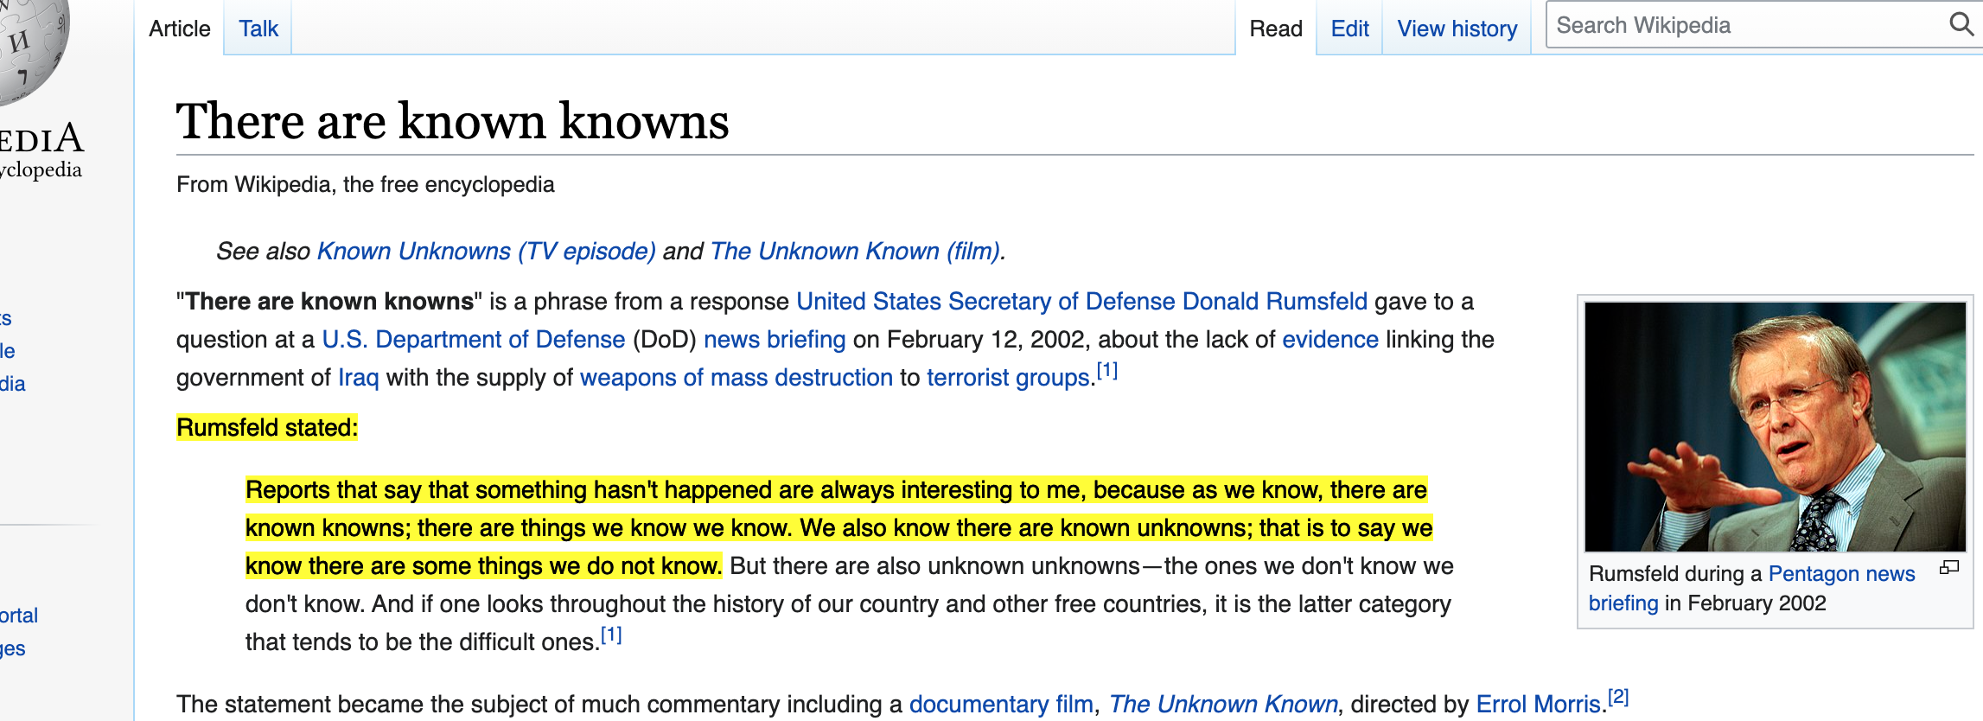
Coporate & Country Risk – Could it Ruin Return on Investment?

Slide 2
Corporate & Country Risk
By 2025, 70% of attacks against containers will be from known vulnerabilities and misconfigurations that could have been remediated.
By 2025, organisations will speed up their remediation of coding vulnerabilities identified by SAST by 30% with code suggestions applied from automated solutions, up from less than 1% today, reducing time spent fixing bugs by 50%.
By 2024, the provision of a detailed, regularly updated software bill of materials by software vendors will be a non-negotiable requirement for at least half of enterprise software buyers, up from less than 5% in 2019.

Slide 3

Test Exception Briefs … Not enough? … Eeeeek! … Are we safe?

Slide 4
Corporate & Sovereign Risk
Gartner has observed the major driver in the evolution of the AST market is the need to support enterprise DevOps initiatives.
Customers require offerings that provide high-assurance, high-value findings while not unnecessarily slowing down development efforts.
Cos. Increasingly employ AST for mobile apps. AST toolsets & methods of behavioural analysis, are used to analyse source, byte/binary code, and observe - behaviour of mobile apps to identify coding, design, packaging, deployment and runtime conditions that introduce security vulnerabilities.

Slide 5
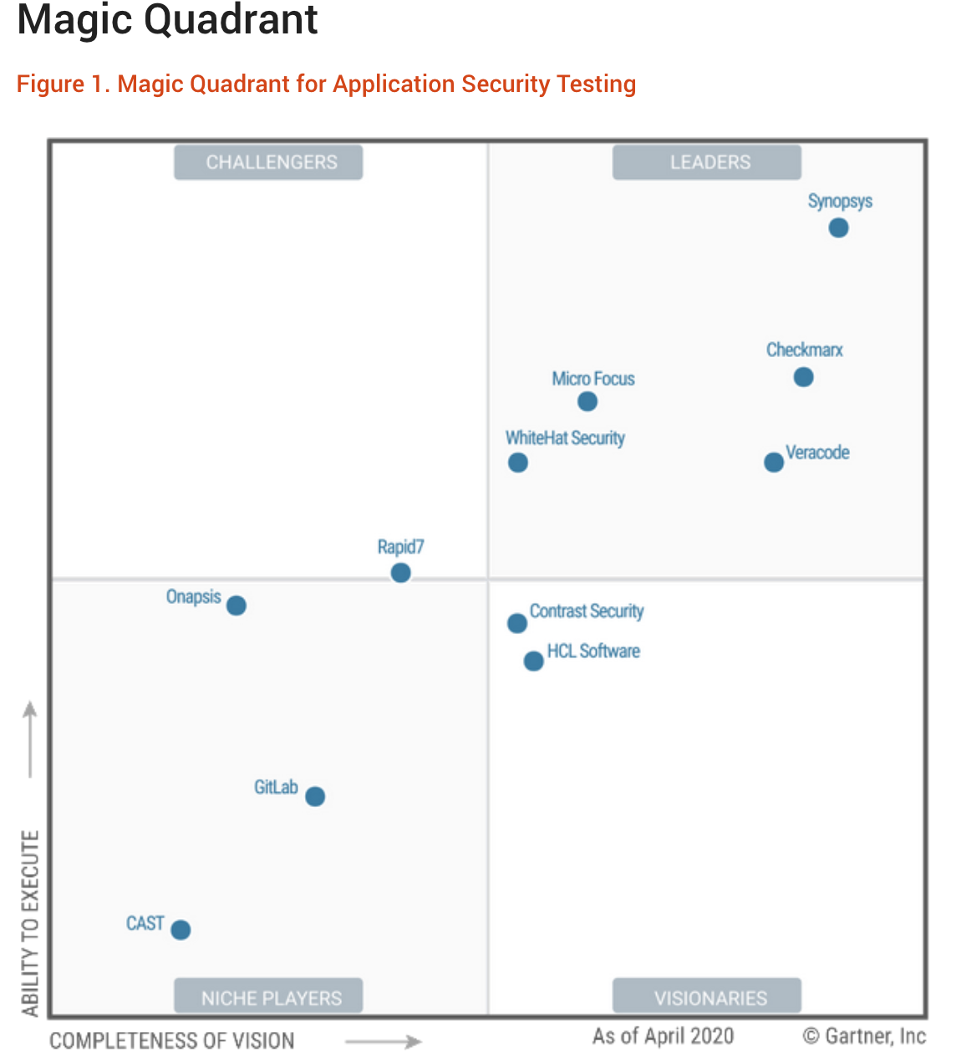
Are Test Exception Briefs… Not enough?

Slide 6
AST Solutions Technologies
Synopsis
CheckMarx
Micro Focus
WhiteHat Security
VeraCode

